Slide 1
Settlements
Department of Geography
Government College Paonta Sahib

Slide 2
Types of settlements
Rural settlement
Urban settlement

Slide 3
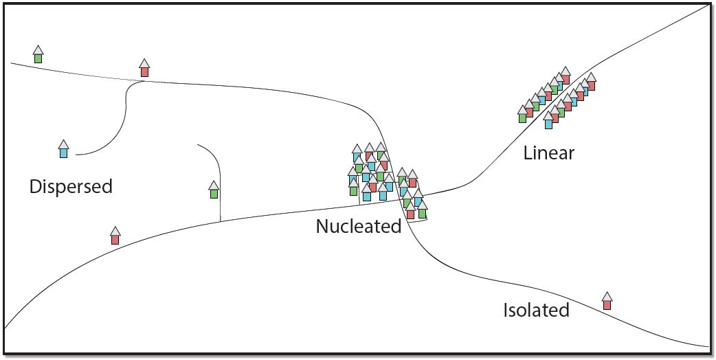
Rural settlement

Slide 4
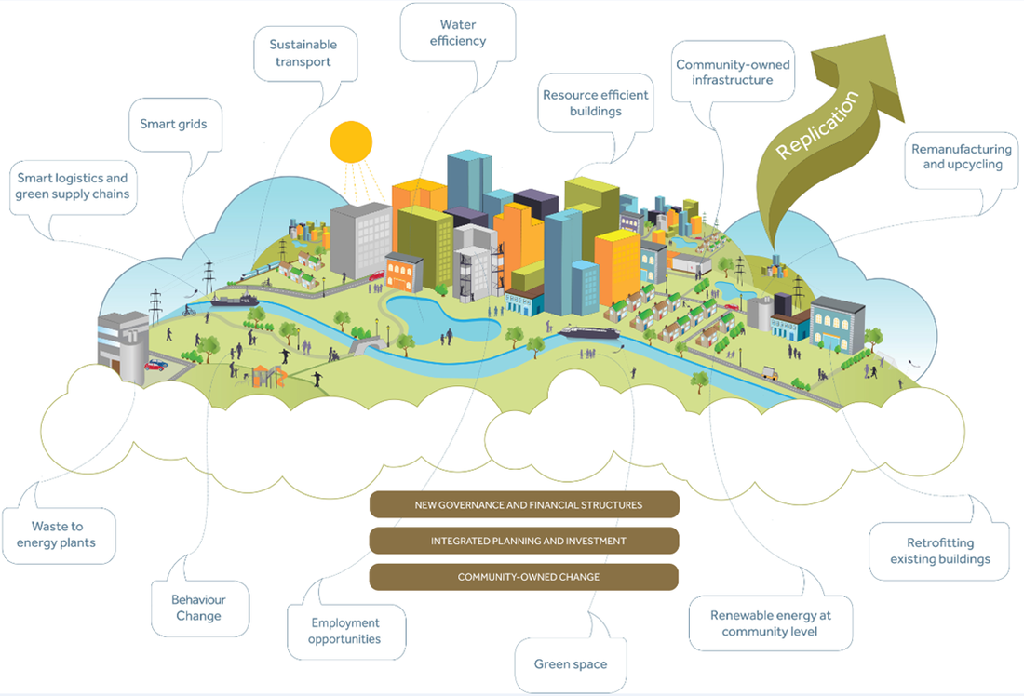
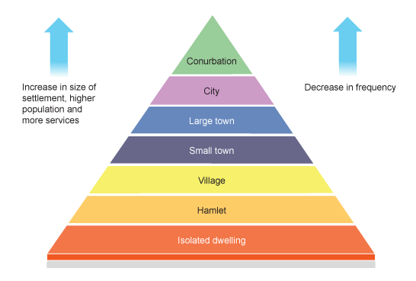
Urban Settlement

Slide 5
Thank you
Government college Paonta Sahib

